Slide 1
Soil Analysis For Crop rEcommendation
By:-
Harish Natarajan
Dereck Jos
Ajit Ade
Guided by:
Prof. Ankit Anand

Slide 2
Table Of Content
Introduction
Use Case Diagram
Soil Fertility Analysis
Crop Recommendation
Azure Deployment
Web View Overview
Enabling Web View
Advantages Of Web View Over Rest API
Existing v/s Proposed System
Future Plans

Slide 3
Introduction
Chemical imbalance in the soil can disrupt the natural growth of plants. So by knowing the fertility level of soil good quality of plants can be grown.
This app predicts fertility levels of soil based on available nutrients such as Nitrogen, Sulphur, Phosphorus, Barium, Potassium, Iron, Magnesium in ppm, parameters such as organic carbon and electrical conductivity is also taken in consideration.
Based on the fertility level predicted from the above features and the level of rainfall the app also recommend suitable crop to be grown in that region.

Slide 4
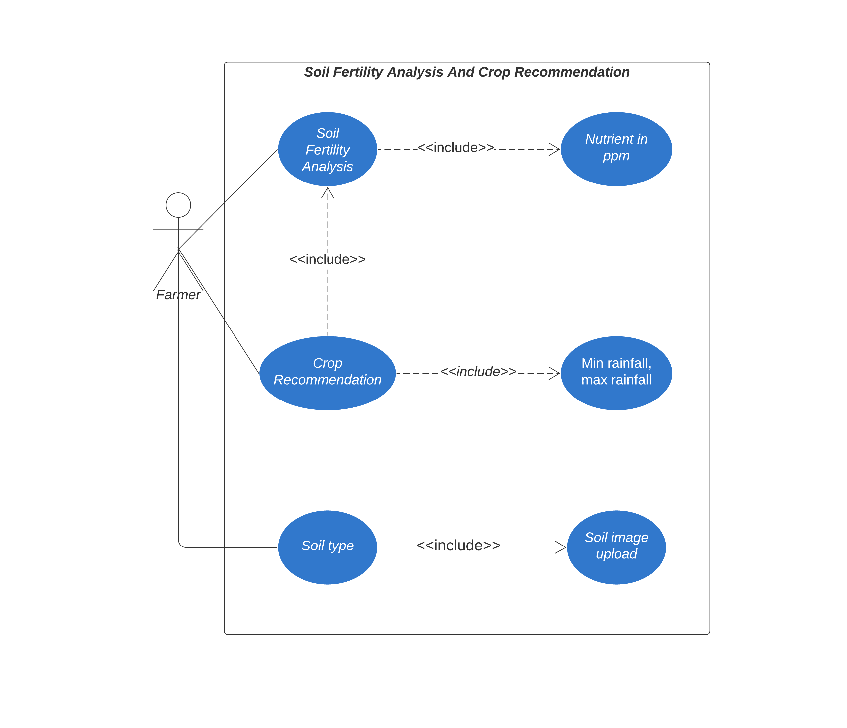
USE CASE DIAGRAM

Slide 5
Soil Fertility Analysis
This app predicts the fertility level of the soil using machine learning algorithm known as Random Forest Classifier.
Value of each nutrients is given as an input for which the model would predict the fertility level.

Slide 6
Crop Recommendation
K-Means clustering algorithm is used to recommend crops based on predicted fertility, min rainfall and max rainfall.
Elbow plots was used to calculate the number of clusters. The optimum number of cluster was six.

Slide 7
Azure Deployment
Our web app is deployed by using Azure cloud.
We will be using Azure web app service which is PaaS model(Platform as a Service)

Slide 8
Web view Overview
WebView is a view that display web pages inside our application. We can also specify HTML string and can show it inside your application using WebView. WebView makes turns your web application to a mobile application.
Web view was used to convert our web application into android application.

Slide 9

Enabling web view
In order to add WebView in the application, we have to add <WebView> element to our xml layout file. Syntax is as follows:
In order to use it, we have to get a reference of this view in Java file. To get a reference we have to create an object of the class WebView. Syntax is as follows:
In order to load a web url into the WebView, you need to call a method loadUrl(String url) of the WebView class, specifying the required url. Syntax is as follows:

Slide 10
Advantages Of Web View Over Rest API
We can easily convert web application to android application without much android knowledge.
Many business organization who are having their own websites uses android web view initially to run their business till they hire android developers.
Using web view we can make hybrid apps(ex. android, ios).

Slide 11
Existing vs Proposed System
Existing | Proposed
Soil is tested and analyzed to know the fertility level. | Value of nutrients can be given as an input and automatically fertility level can be determined.
Slow process since it involves human experts. | Fast process since it is computerized.
Difficult for farmers to know the fertility level. | Since it is web app it is easy to handle.

Slide 12
Future Plans
Currently generalized prediction is generated, in future we would like to include district wise predictions.
We would give prediction for fertility based on current location of user.
We are planning to add chatbot in our web app.
We would give visual analytics of soil fertility.

